Slide 1
Hate Crimes Project 1
Anthony Avitia, Ashley Nesmith, Stephanie Plaza, & Tiara Green - Private Investigators

Slide 2
Objectives:
Data Used:
What are the most common / least common hate crimes?
Which states had the most amount of hate crimes?
What are the top/bottom 5 cities with the most/ least hate crimes?
Are there peak times when hate crimes are committed?
Is there a specific offender type?
FBI Crime Data Explorer - csv file

Slide 3
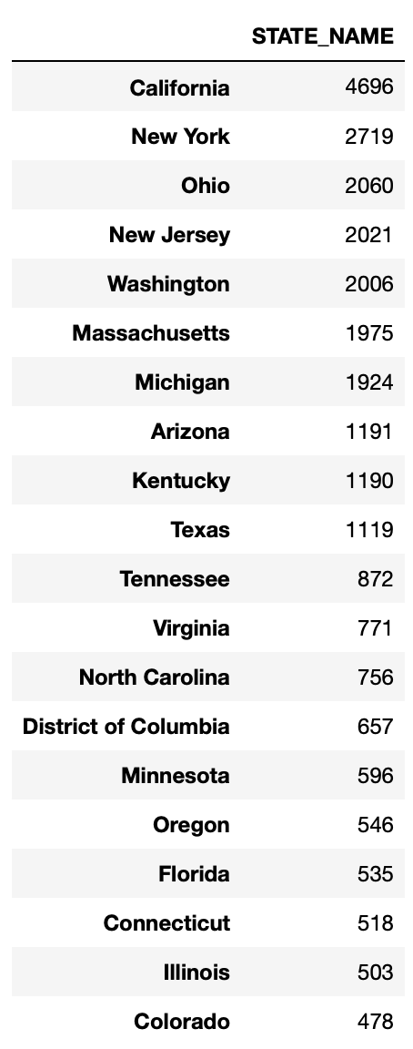
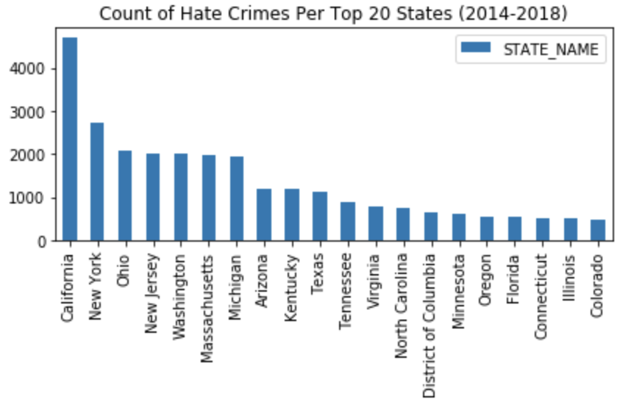
Top 20 States With The Most Hate Crimes
2014-2018
Texas - 10th on the list of Hate Crimes (2014-2018)

Slide 4
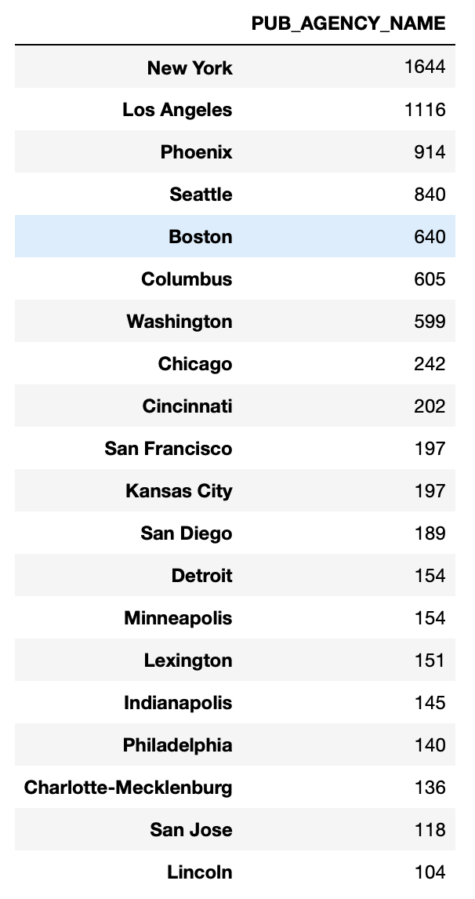
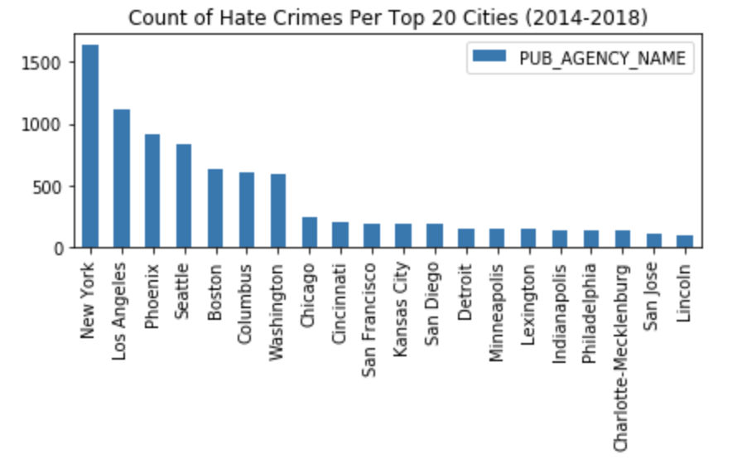
Top 5 Cities With The Most Hate Crimes
2014-2018
Filter data through years of 2014 - 2018.
TOP 5 CITIES: New York (1644), Los Angeles (1116), Phoenix (914), Seattle (840), Boston (640).
Houston - 26th and San Antonio - 46th, respectively.

Slide 5
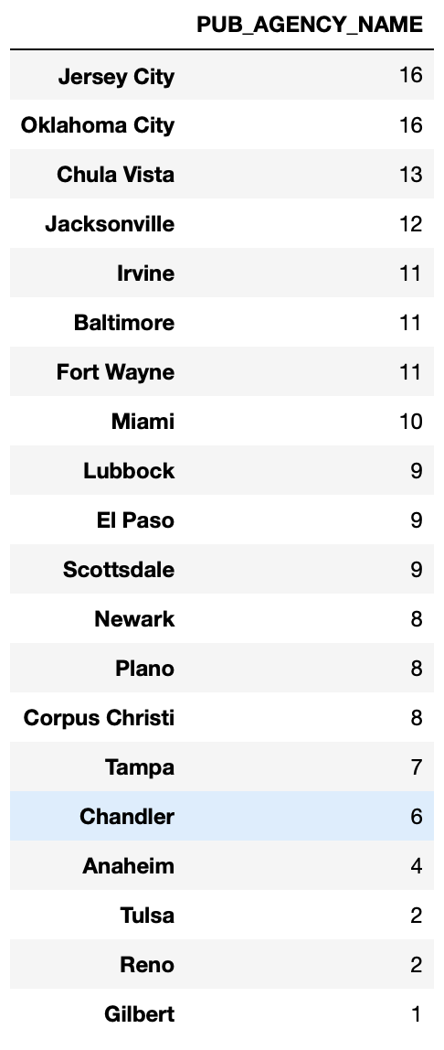
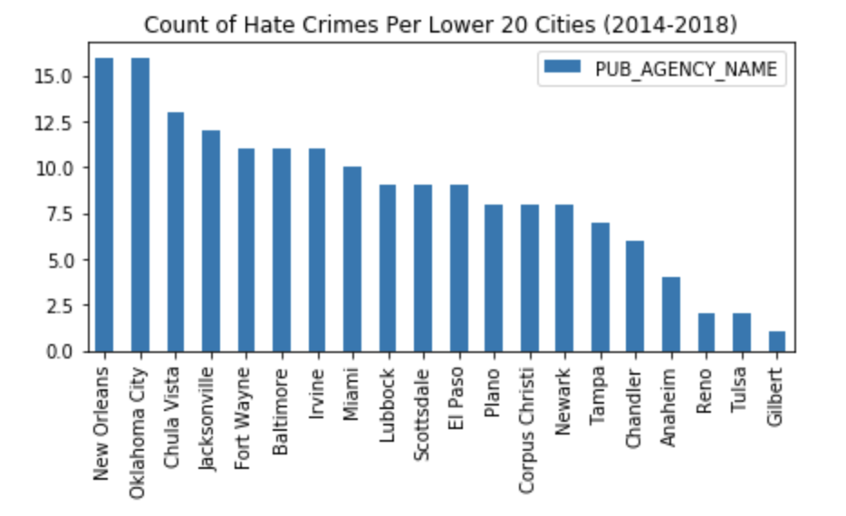
5 Safest Cities In Terms Of Least Hate Crimes
2014-2018
Filter data through years of 2014 - 2018.
Populate the 20 safest cities in amount of hate crimes.
5 SAFEST CITIES: Gilbert (1), Reno (2), Tulsa (2), Anaheim (4), Chandler (6).

Slide 6
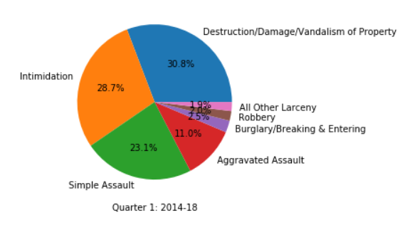
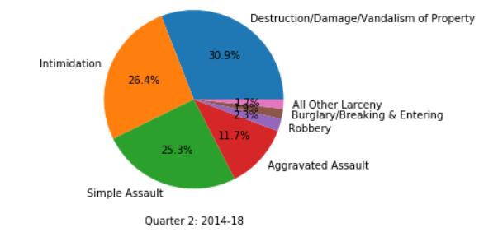
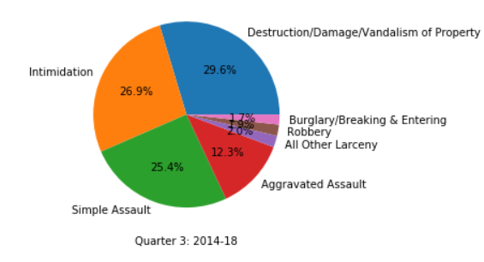
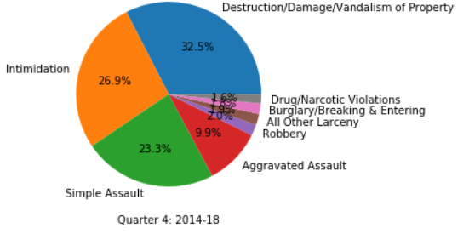
Offense Crime Rate Per Quarter
For 5 year period
Notes:
You can see there isn’t much differentiation for the types of crime and because of data limitations there isn’t a way to determine why there is no major difference quarter to quarter
Destruction/Damage/Vandalism is the highest committed crime in all quarters
Crime by quarter. Thinking that the types of crimes like robbery and burglary would see an increase around the 4th quarter since that is the holiday season

Slide 7
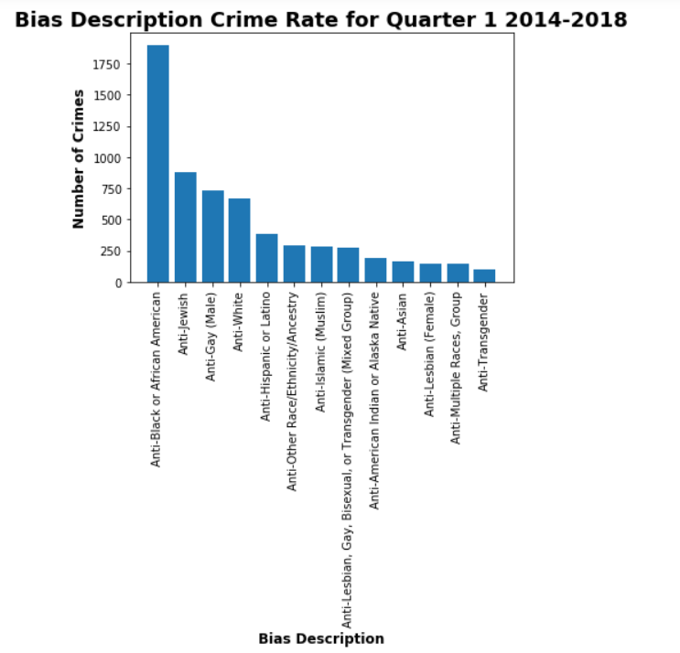
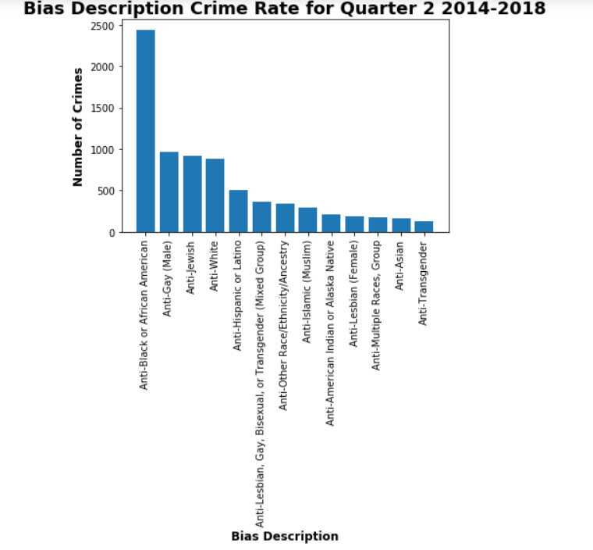
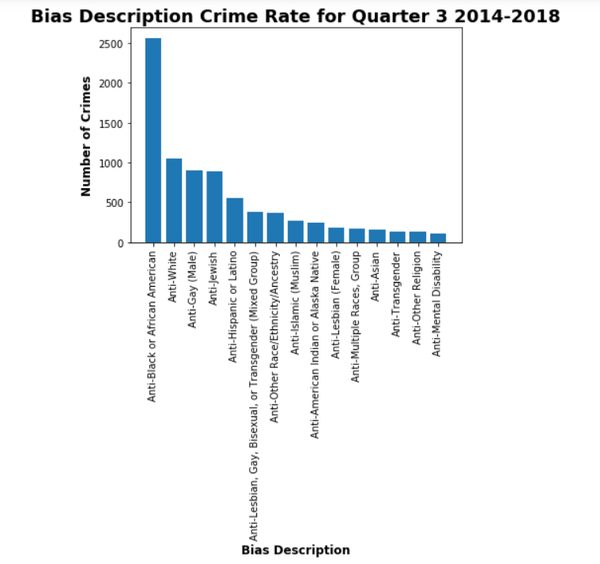
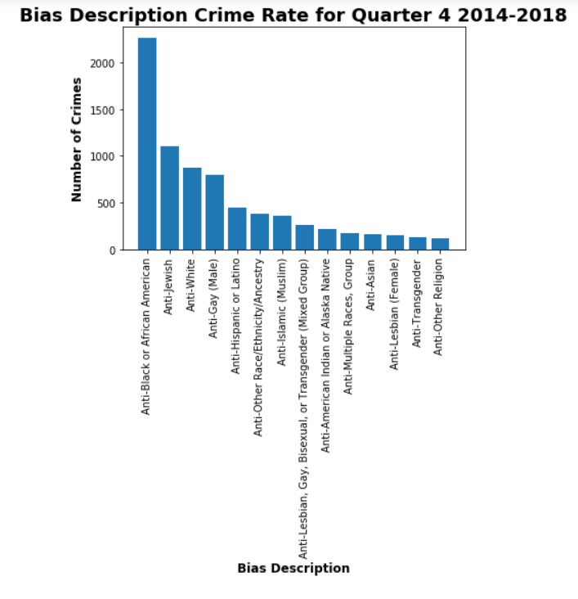
Bias Description Crime Rate Per Quarter
For 5 Year Period
Notes:
We looked at peak quarters for bias description to see who were the groups being targeted for hate crimes and if there was any correlation to times of year or Holidays
For example, African Americans are the most targeted group across the quarters, but during quarter 1 were the least crimes committed against AA. Quarter one includes Black History month
Women’s Month is in march, and as you can see Anti- Lesbian (female) category experienced less crimes being committed against the group.
In the fourth quarter, October is Pride Month and as you can see Anti-Gay (Female, Male)/LGBTQ(Mixed Group) experienced as a collective being targeted less

Slide 8
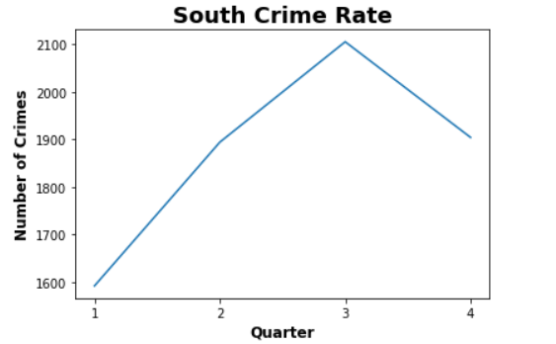
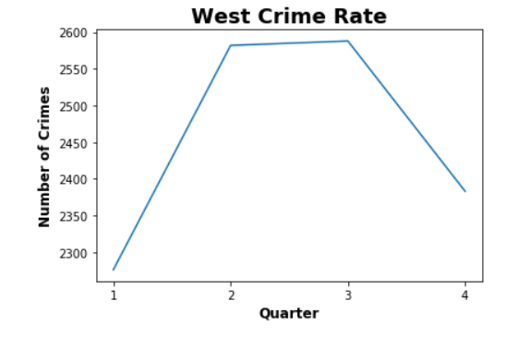
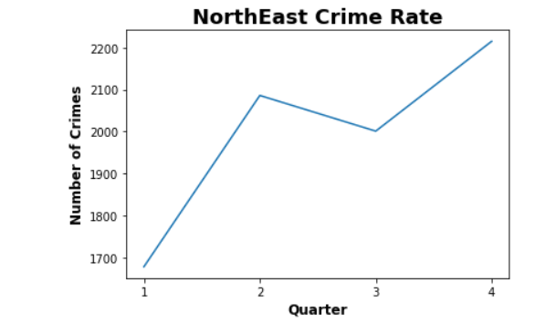
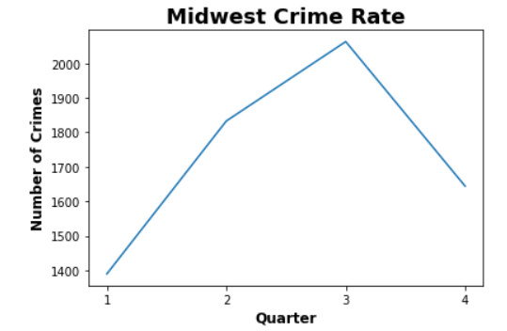
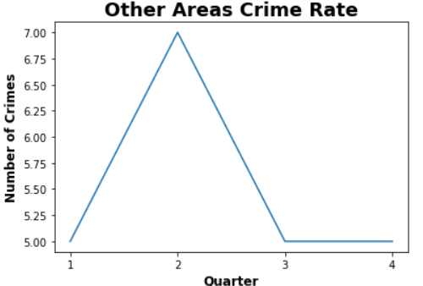
Regional Crime Rate Per Quarter
For 5 Year Period
Notes:
There is a very low level of crime during the All Quarters. We think that could have a correlation with the time of the year. New Year, New Beginnings. Everyone is trying to carry out their new year resolutions
Second and Third Quarter (which are the warmer months) have higher crime rates across all regions.

Slide 9
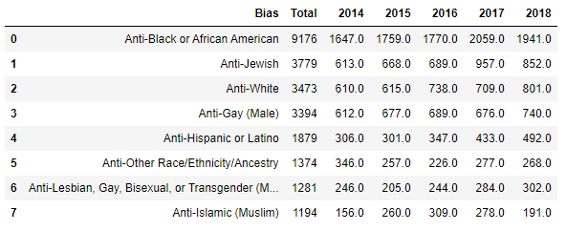
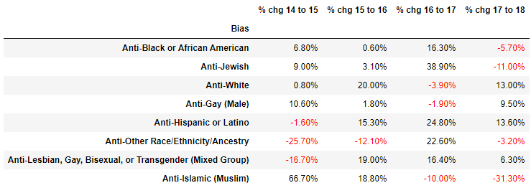
Hate Crimes by Bias - 2014 to 2018
2017 saw the biggest increase in reported hate crimes for most biases. However, those biases that did not increase during 2017, did increase in 2018. Determining a reason would require further research into what was occurring during those years (ex: political change - federal and/or local, economic change, or historic happenings).
Notes:
Added by Stephanie

Slide 10
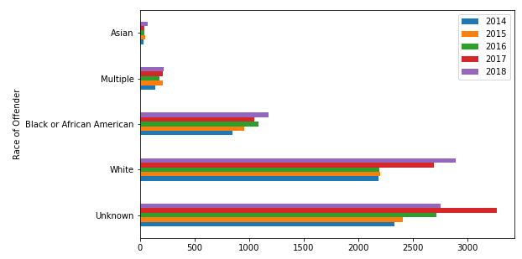
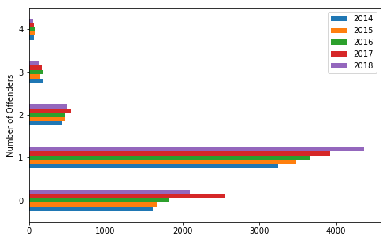
Hate Crimes by Number of Offenders and Offender Race - 2014 to 2018
The reason for an offender’s race to be classified as “unknown,” or the number of offenders listed as “0,” was unable to be determined based on the data.
It is unclear if the offender’s race is determined by visual observation or self-reporting.
Crimes without offenders can include arson, burglary, and vandalism.
Notes:
Added by Stephanie

Slide 11
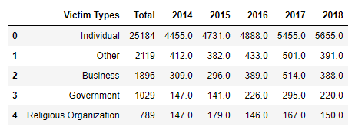
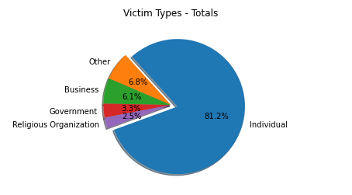
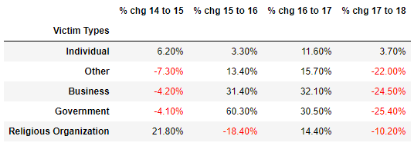
Hate Crime by Victim Type - 2014 to 2018
A majority of hate crimes are committed against an individual. These numbers have continued to increase over the last 5 years, however, the amount of increase has been inconsistent.
Notes:
Added by Stephanie

Slide 12
Most / Least Crimes Introduction
Chosen the top ten crimes for the most crimes committed
Chosen crimes that were more than 20 crime counts for least crimes committed
Combined similar offenses together

Slide 13
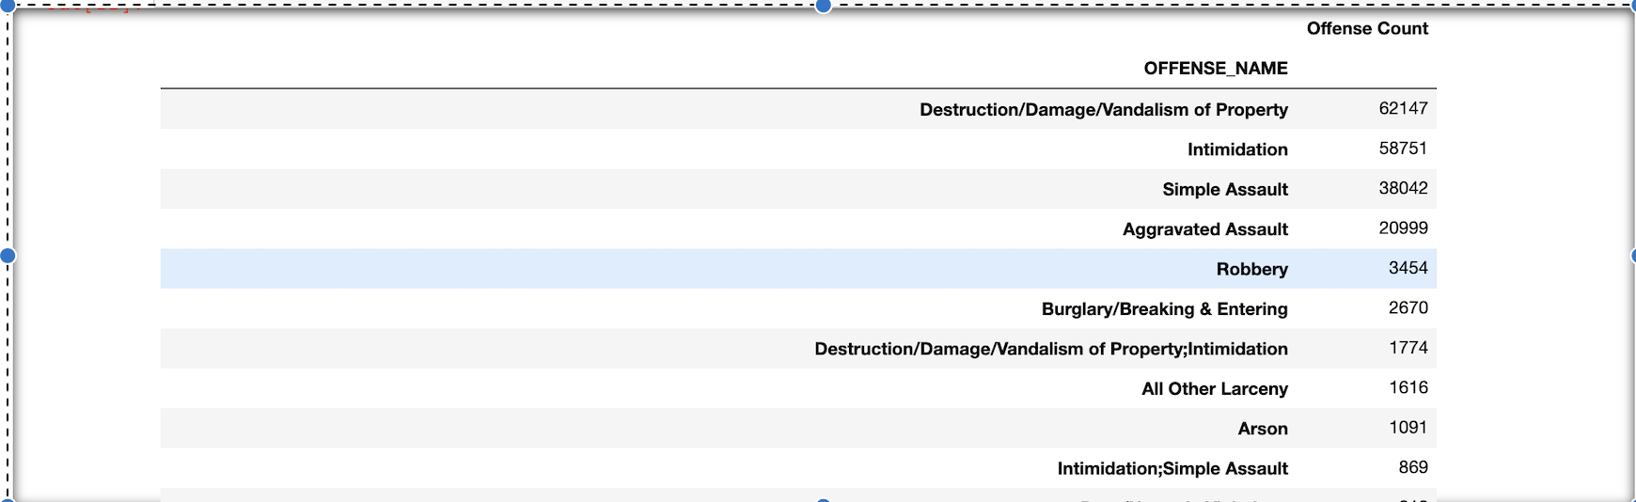
Most Crimes Committed in 2014-2018
The top ten crimes committed between 2014 - 2018 were:

Slide 14
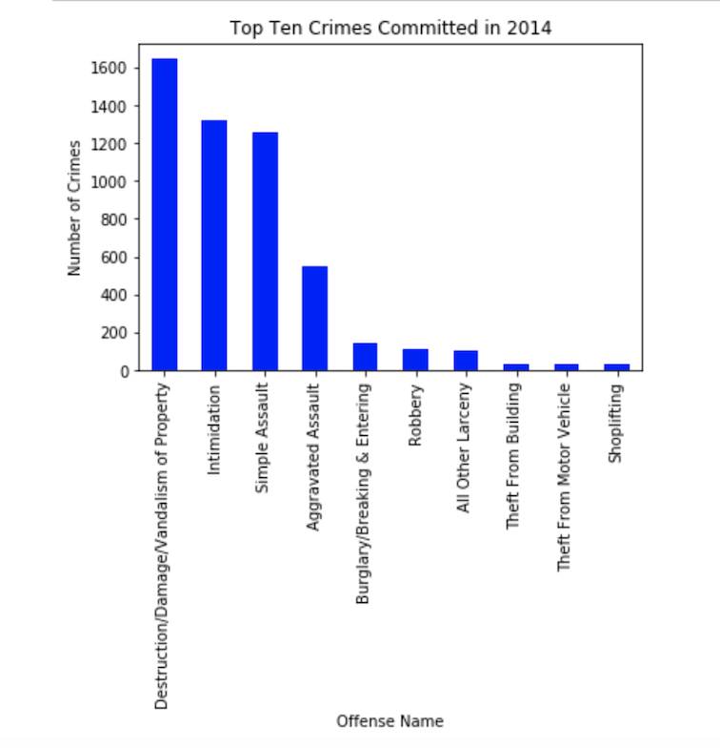
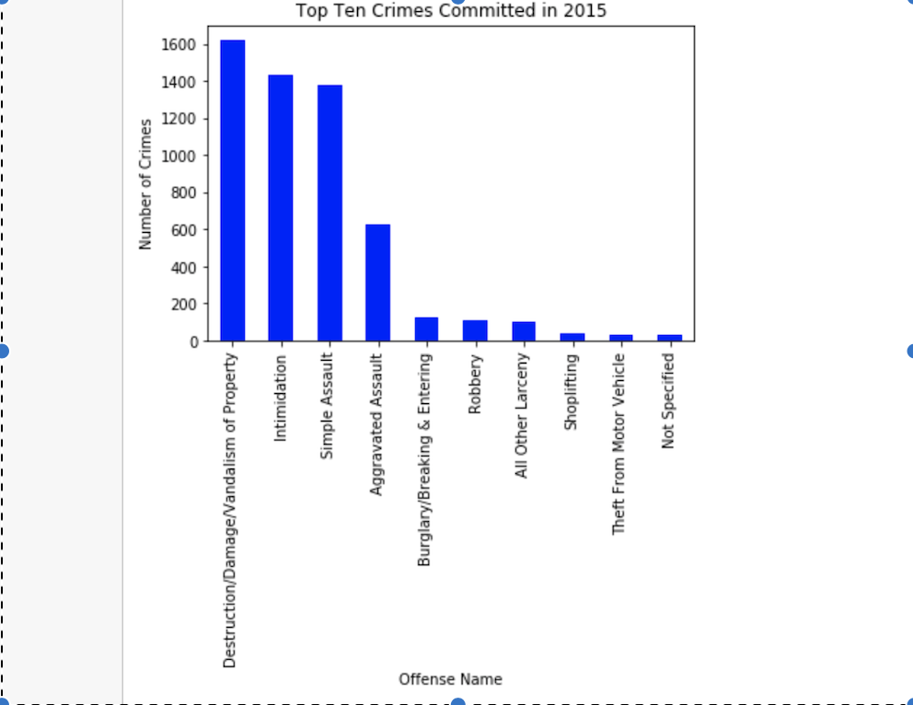
Top Ten Crimes Committed in 2014 - 2015

Slide 15
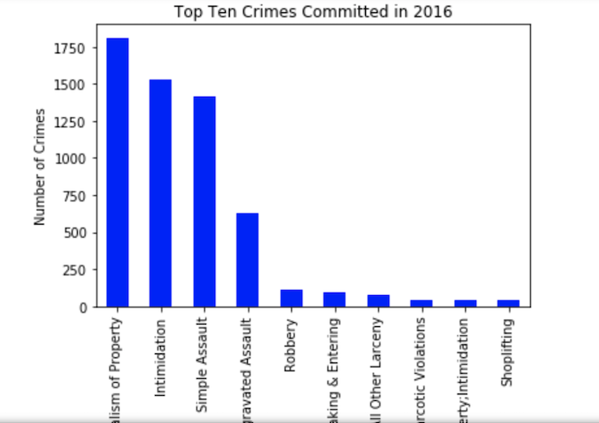
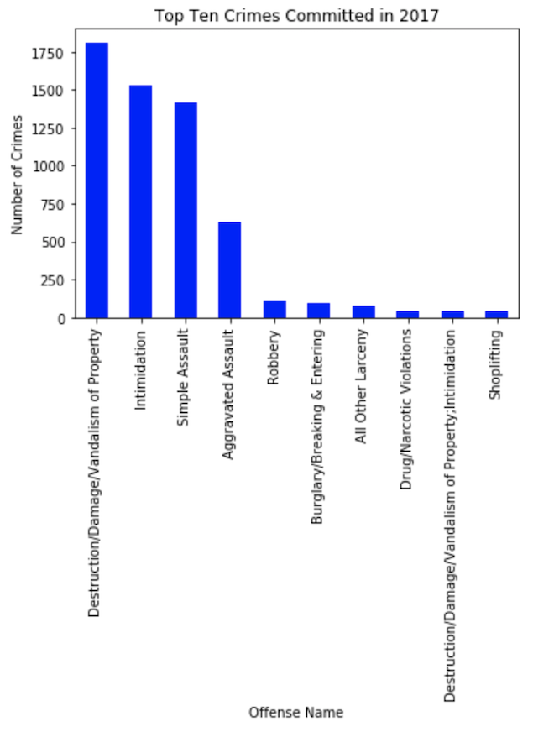
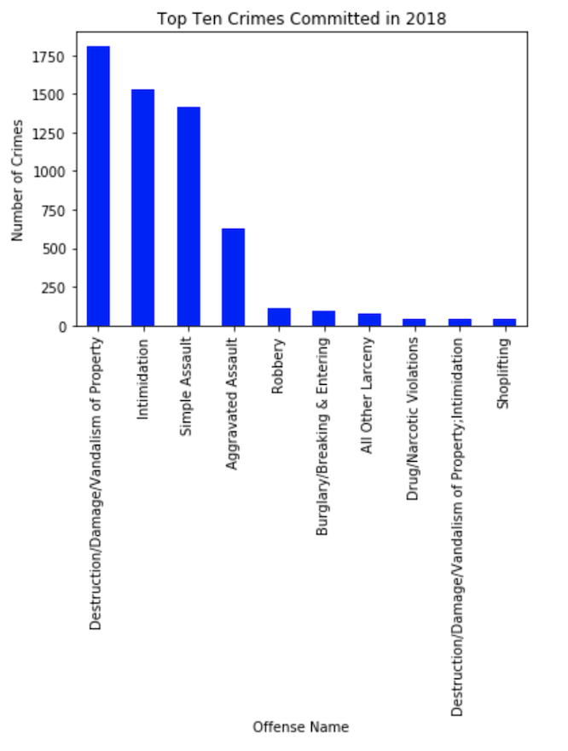
Top Ten Crimes Committed in 2016 - 2018

Slide 16
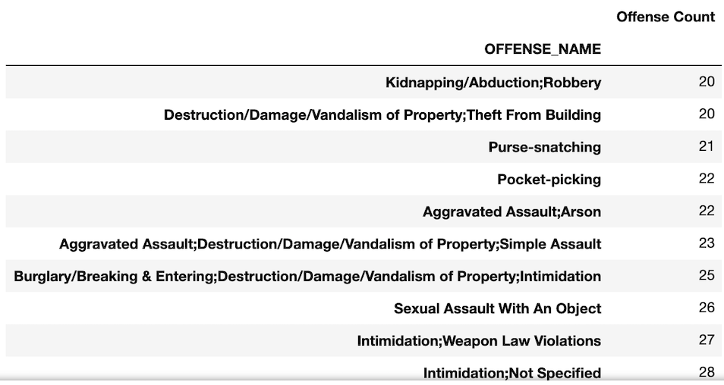
Least Crimes Committed in 2014-2018
The top ten least crimes committed between 2014 - 2018 were:

Slide 17
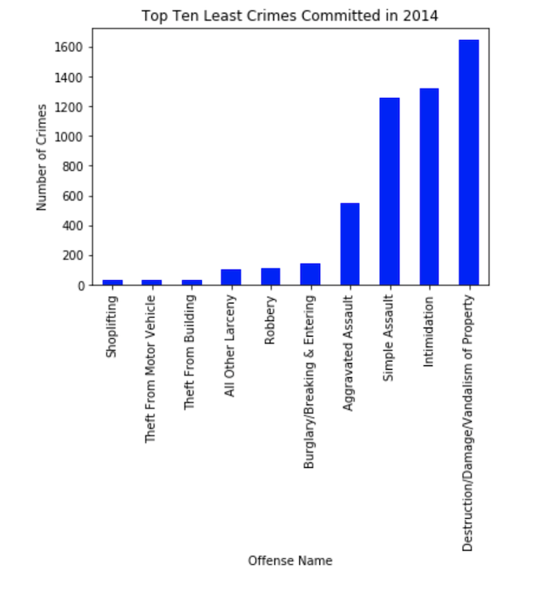
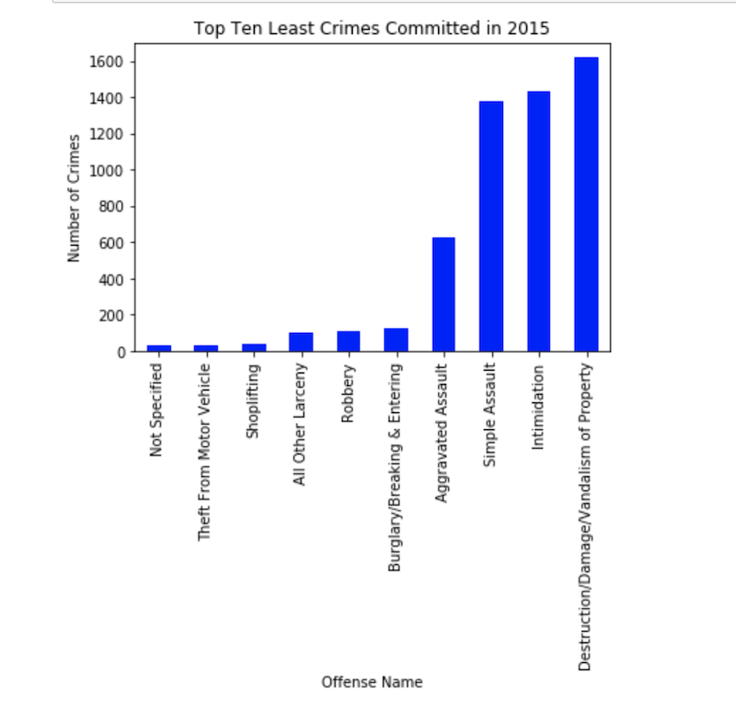
Top Ten Least Crimes Committed in 2014 - 2015

Slide 18
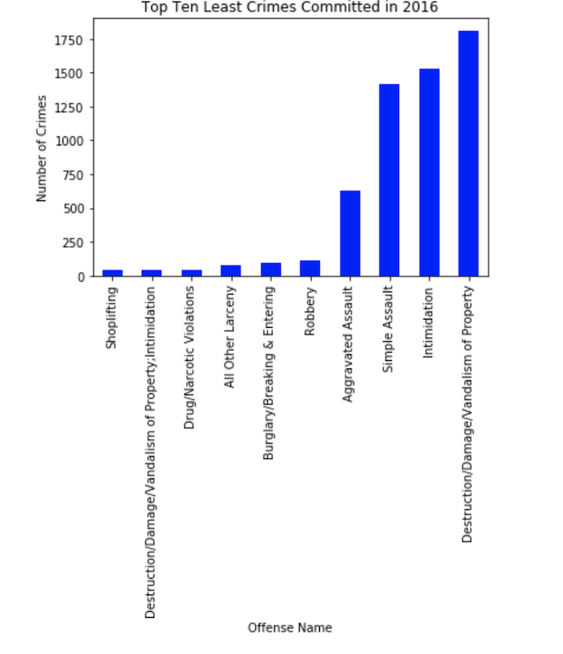
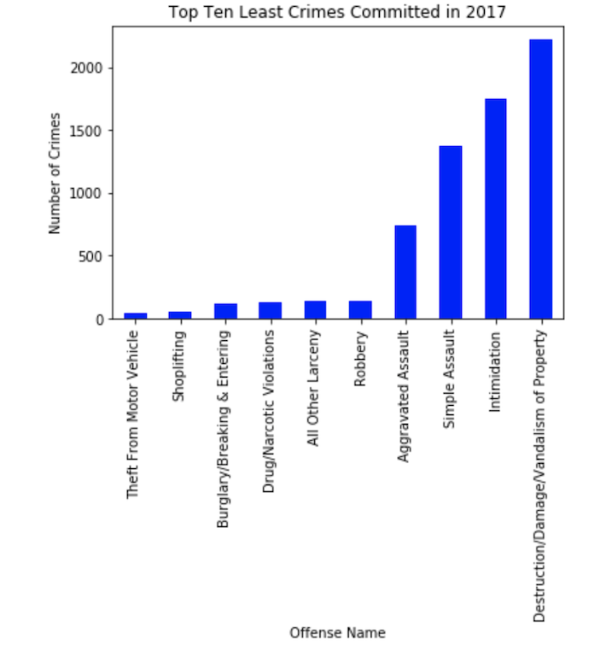
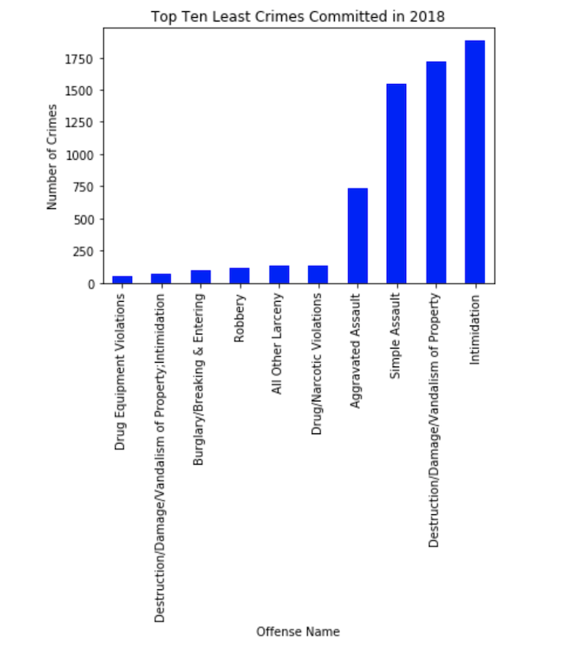
Top Ten Least Crimes Committed in 2016 - 2018

Slide 19
Most / Least Crimes - interesting finds
Destruction/Damage/Vandalism of Property lead the charts for most and least crimes committed
Shoplifting was the lowest in 2014 and 2016
“Theft from Building” was the highest in 2014
Theft/Motor Vehicles was only the lowest in 2017
Drugs/Narcotics didn’t start increasing until 2016

